Slide 1
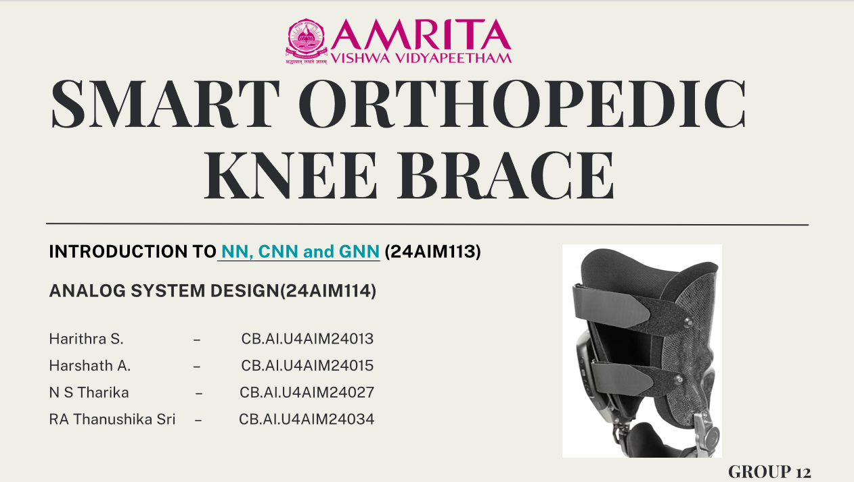

Slide 2
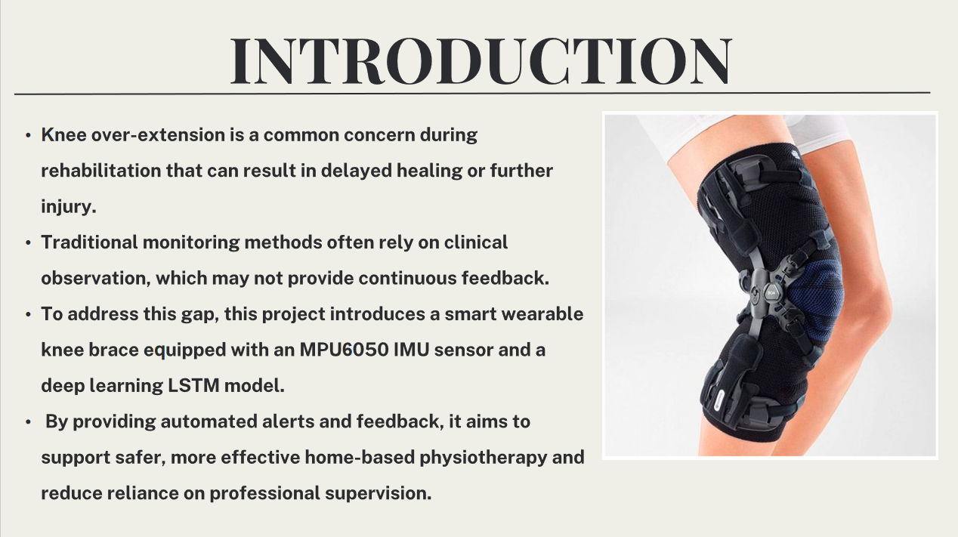
1

Slide 3
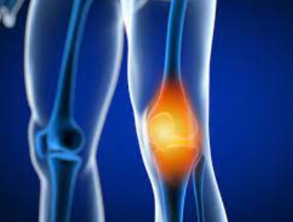
PROBLEM STATEMENT
Knee hyperextension is a frequent issue during rehabilitation that can hinder recovery or lead to additional injuries. Conventional monitoring approaches typically depend on clinical observation, which lacks the ability to offer continuous feedback.
2

Slide 4
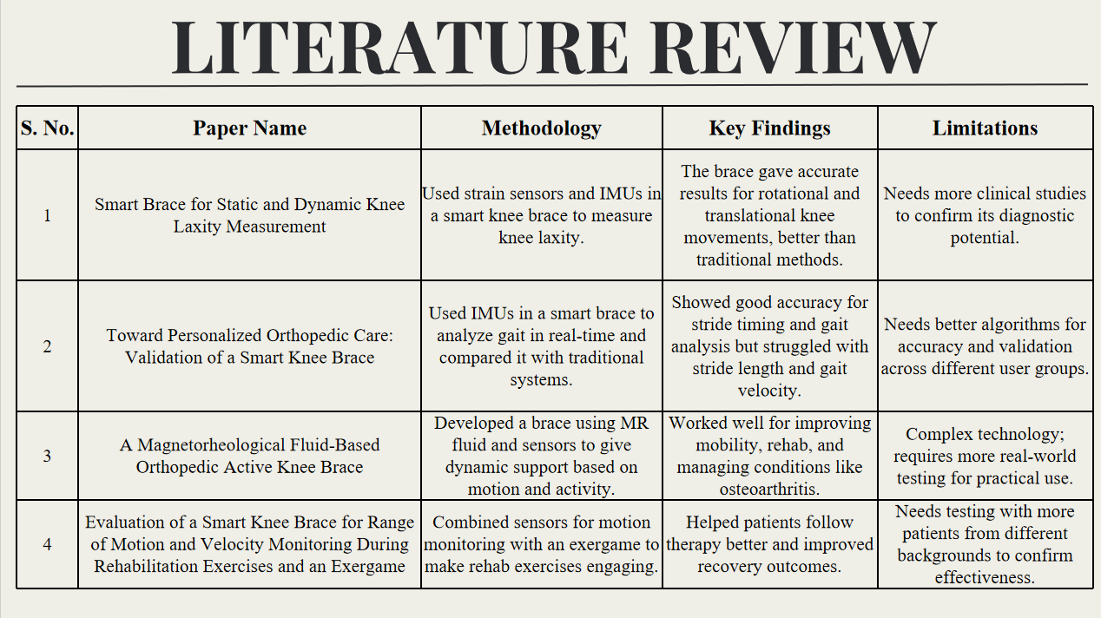
4
3

Slide 5
Hardware Setup and Data Acquisition
Sensor Used: MPU-6050 IMU with a 3-axis gyroscope and 3-axis accelerometer.
Mounting: Sensor mounted on a knee brace to track motions like bending, squatting, and lunging.
Data Transmission: MPU-6050 communicates with an Arduino Uno using the I²C protocol.
Data Processing: Arduino processes raw angular velocity and acceleration data, then sends it to a computing unit via serial communication.
Alert Mechanism: An active buzzer connected to the Arduino provides audio alerts for unsafe movements.
4

Slide 6

IMU Sensor and Bending Angle Estimation
This equation calculates the angle based on the acceleration values along the X, Y, and Z axes.
To improve the stability and accuracy of the angle estimation, , a low-pass filter is applied to the raw accelerometer data.
5

Slide 7
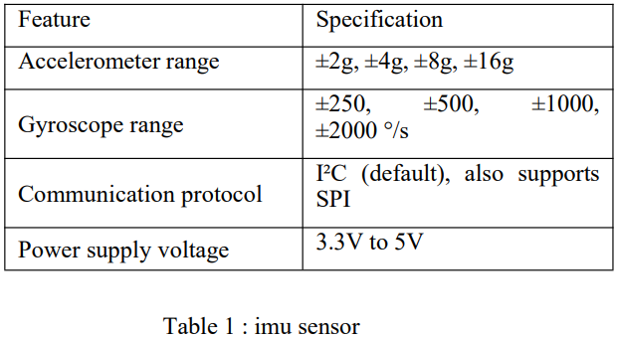
Hardware Components and Specifications
MPU6050 – IMU Sensor
It is used to monitor knee joint orientation and motion in real time during physical activity.
6

Slide 8
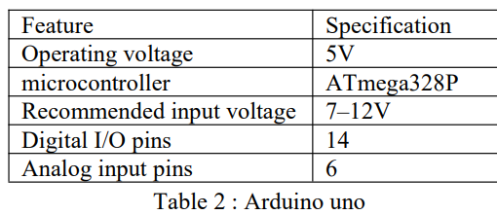
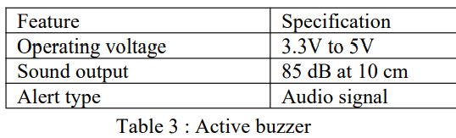
Hardware Components and Specifications
Arduino Uno – Microcontroller
The Arduino Uno acts as the main controller for the system. It reads data from the IMU sensor, processes it to estimate bending angles, communicates with a computing unit, and triggers an alert via the buzzer in real time.
Active Buzzer Module
An active buzzer is used to alert the user when an abnormal knee movement (over-extension) is detected by the LSTM model.
7

Slide 9
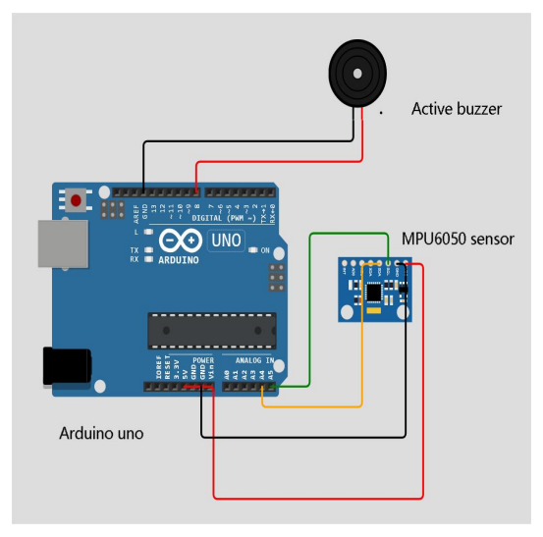
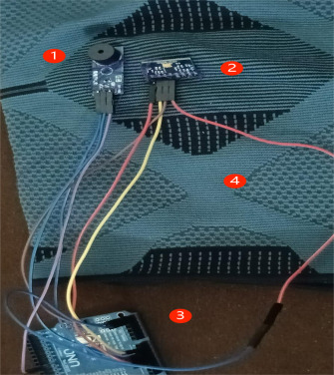
CONNECTIONS
9

Slide 10
LSTM MODEL ARCHITECTURE
Input Layer
First LSTM Layer
Dropout Layer
Second LSTM Layer
Dropout Layer
Output Layer
The input to the model is a time-series sequence of shape (20, 7), where 20 represents the number of time steps, and 7 features include the three-axis accelerometer readings (ax, ay, az), three-axis gyroscope readings
(gx, gy, gz), and the calculated knee bending angle.
An LSTM layer with 64 units and was employed to extract temporal features across the full input sequence. The output at every layer is passed on to the next recurrent layer for further processing.
A Dropout layer with a dropout rate of 0.3 was applied after the first LSTM layer to reduce the risk of overfitting by randomly deactivating 30% of neurons during training.
A second LSTM layer with 32 units was included to refine the sequential features extracted from the previous layer. This layer outputs only the final layer., This final layer is a summary of the whole 20-step input sequence.
Another Dropout layer with a rate of 0.3 was added after the second LSTM to further enhance model generalization and robustness.
The final output layer is a dense layer with 1 unit and a sigmoid activation function. This configuration outputs a probability score between 0 and 1, appropriate for binary classification. A threshold is applied such that:
Output ≈ 0 indicates overextension
Output ≈ 1 indicates normal movement
10

Slide 11
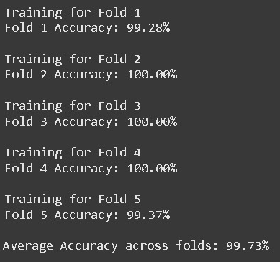
VALIDATION STRATEGY
Our dataset is split into 5 parts (folds).
Model is trained on 4 folds and validated on the remaining 1 fold.
This is repeated 5 times, each time with a different fold as the validation set.
Ensures model isn’t performing well just by chance or due to a lucky data split.
Especially important for small to medium-sized datasets like IMU.
11

Slide 12
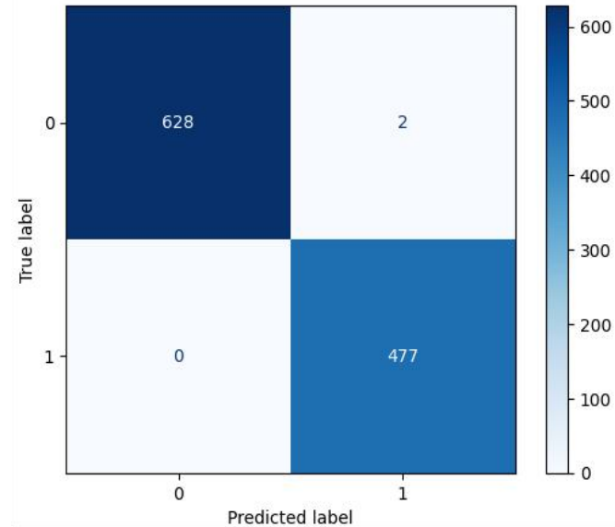
CONFUSION MATRIX
0 indicates overextension
1 indicates normal movement
628 normal movements were correctly identified as safe
477 risky overextensions were correctly flagged
2 safe movements were incorrectly flagged as risky (False positives
0 dangerous overextensions were missed (No false negatives)
13

Slide 13
ADAM OPTIMIZER
Adam stands for Adaptive Moment Estimation.
It is an optimization algorithm used to update weights in neural networks, combining the advantages of:
Momentum (helps smooth out updates)
RMSProp (scales the learning rate adaptively)
It uses past gradient to guide future updates and adjusts learning rate for each weight and is fast and efficient in handling large and noisy data
13

Slide 14




EVALUATION METRICS
Accuracy:The percentage of total predictions that were correct.
F1 Score: Harmonic mean of precision and recall.
Precision: Proportion of correctly predicted positive observations to the total predicted positive observations.
Recall(Sensitivity):Proportion of correctly predicted positive observations to all actual positives.
12

Slide 15
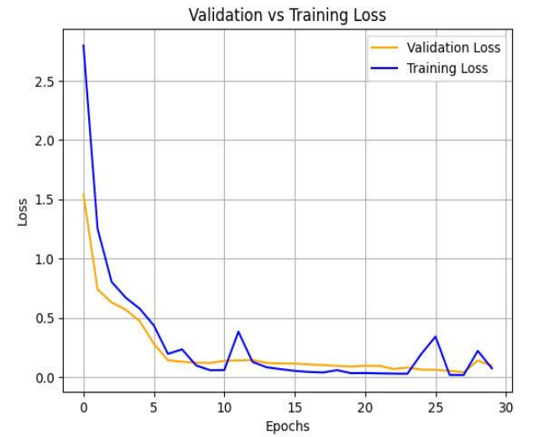
LEARNING CURVE
X-axis: Epochs (0 to 29) → 30 epochs Y-axis: Loss values
Blue line: Training loss ≈ 0.05
Orange line: Validation loss ≈ 0.02–0.04
Training accuracy: 0.9945
Training loss: 0.0356
Validation Loss: 0.0404
Validation Accuracy: 0.9937
14

Slide 16

15

Slide 17
THANK YOU..!!

